Slide 1
Checking and securing converting mixed numbers to improper fractions
Comparing and ordering fractions and decimals (positive and negative)

Slide 2
how to use Oak lessons

Slide 3
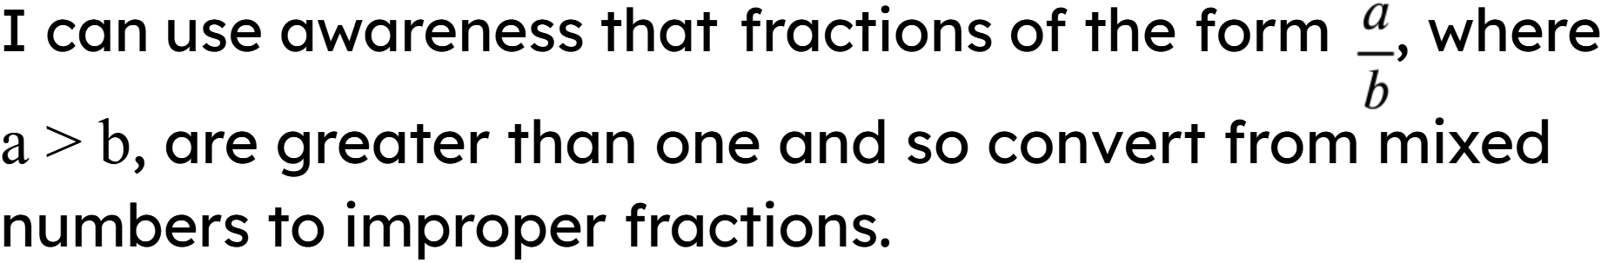

Slide 4



A proper fraction is a fraction where the numerator is less than the denominator.
Example
An improper fraction is a fraction where the numerator is greater than or equal to the denominator.
Example
A mixed number is an improper fraction written as its integer part plus the fractional part, where the fractional part is a proper fraction.
Example

Slide 5

Checking and securing converting mixed numbers to improper fractions
Integers as improper fractions
Mixed numbers to improper fractions
Comparing mixed numbers and improper fractions

Slide 6


Integers as improper fractions
An improper fraction is a fraction where the numerator is greater than or equal to the denominator.
Example
Example
Non example
We also know when the numerator is equal to the denominator this is 1.

Slide 7

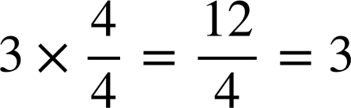
Integers as improper fractions
Can you explain the improper fraction represented here if each bar is worth 1 whole?
because a whole is represented as 4 equal parts
We have 3 whole bars, so it is

Slide 8
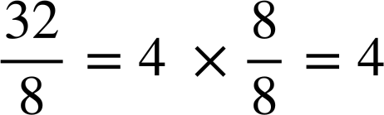
Integers as improper fractions
Can you explain the improper fraction represented here?
because a whole is represented as 8 equal parts
We have 4 whole bars, so it is

Slide 9
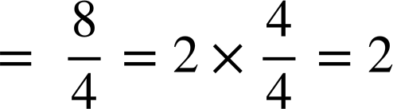

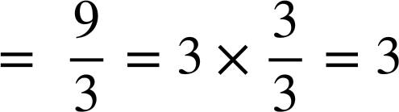

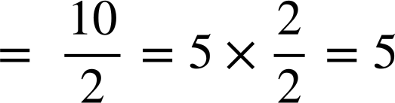
Integers as improper fractions
Fill in the missing gaps to write the improper fraction. Identify the calculation and work out the integer answer to each of the following
a)
b)
c)

Slide 10
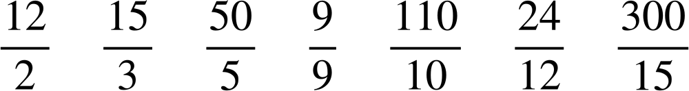
Integers as improper fractions
Match the improper fraction with the correct integer.

Slide 11
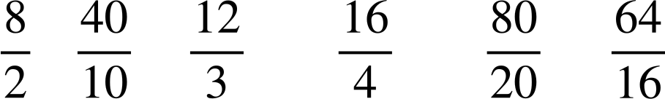
Integers as improper fractions
Fill in the gaps to evaluate the answer to 4.
4

Slide 12
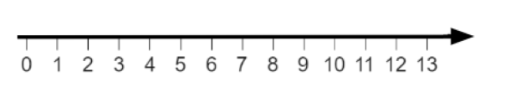
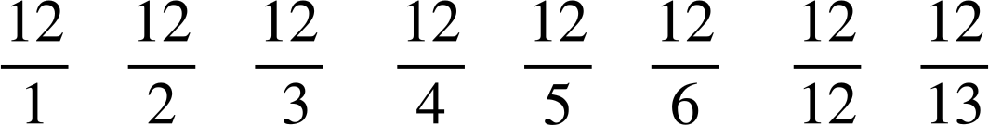
Integers as improper fractions
Place the following on the number line.
a)
e)
b)
f)
c)
g)
Estimate
where
would lie.
d)
h)
Estimate
where
would lie.

Slide 13




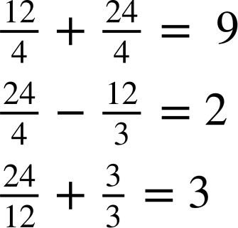
Integers as improper fractions
The
,
,
and
are either
3
4
12
24
To make the above calculations correct, work out the value of the images.
=
=
=
=

Slide 14
Integers as improper fractions
Match the improper fraction with the correct integer.

Slide 15
Integers as improper fractions
Fill in the gaps to evaluate the answer to 4.
There are an infinite number of improper fractions which evaluate to 4
4

Slide 16
Integers as improper fractions
Place the following on the number line.
F
E
D
C
B
A
H
G
a)
e)
b)
f)
c)
g)
Estimate
where
would lie.
d)
h)
Estimate
where
would lie.

Slide 17
Integers as improper fractions
The
,
,
and
are either
3
4
12
24
To make the above calculations correct, work out the value of the images.
=
=
=
=

Slide 18
Checking and securing converting mixed numbers to improper fractions
Integers as improper fractions
Mixed numbers to improper fractions
Comparing mixed numbers and improper fractions

Slide 19
Mixed numbers to improper fractions
A mixed number is an improper fraction written as its integer part plus the fractional part, where the fractional part is a proper fraction.
Example
It is sometimes important to convert mixed numbers into improper fractions and vice versa.
So let’s look at how we can effectively convert a mixed number into an improper fraction.

Slide 20

Mixed numbers to improper fractions
It is important to understand what the mixed number means.
Example
an improper fraction with a denominator of 7
We have 5 whole ones

Slide 21
Mixed numbers to improper fractions
It is important to understand what the mixed number means.
Example
How can we write 5 whole ones as an improper fraction using a denominator of 7?
an improper fraction with a denominator of 7

Slide 22
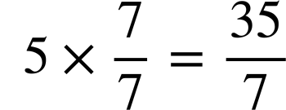
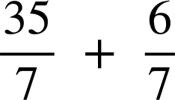

Mixed numbers to improper fractions
It is important to understand what the mixed number means.
Example

Slide 23
Mixed numbers to improper fractions
It is important to understand what the mixed number means.
So we have now converted our mixed number into an improper fraction

Slide 24
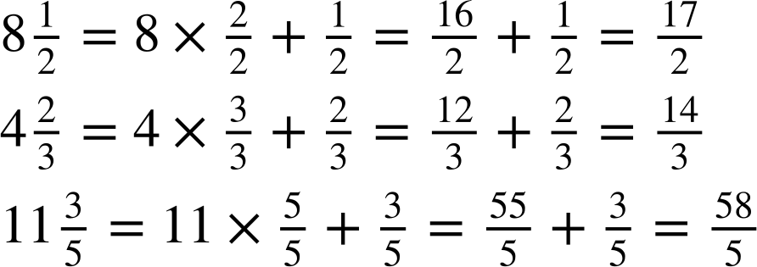
Mixed numbers to improper fractions
Fill in the blanks to show the working out and the conversion from a mixed number to an improper fraction.
a)
b)
c)

Slide 25
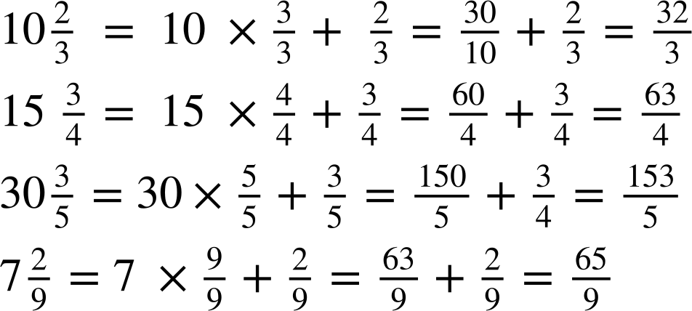
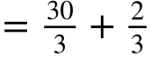

Mixed numbers to improper fractions
Convert to an improper fraction, showing working out if you need.
Convert to an improper fraction, showing working out if you need.

Slide 26
Mixed numbers to improper fractions
Fill in the blanks to show the working out and conversion from a mixed number to an improper fraction.
a)
b)

Slide 27
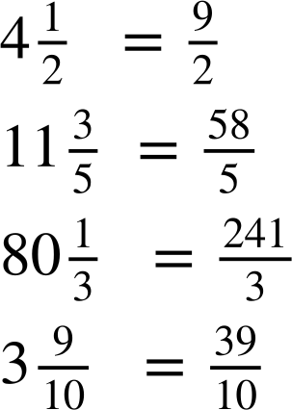
Mixed numbers to improper fractions
Convert the following to improper fractions, showing working out if you need.
a)
b)
c)
d)

Slide 28
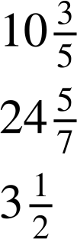
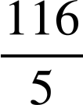
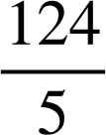

Mixed numbers to improper fractions
Can you work out the mixed number given the clues for the integer and proper fraction?
Write your own mixed number with clues.
The integer is even.
The numerator and denominator of the proper fraction are both odd and prime numbers.
The integer is even.
As an improper fraction the numerator is 173.
The denominator is odd.
The mixed number is
The mixed number is
between
and
between
and 10.7

Slide 29
Mixed numbers to improper fractions
Fill in the blanks to show the working out and conversion from a mixed number to an improper fraction.
a)
b)

Slide 30
Mixed numbers to improper fractions
Convert the following to improper fractions, showing working out if you need.
a)
b)
c)
d)

Slide 31
Mixed numbers to improper fractions
Can you work out the mixed number given the clues for the integer and proper fraction?
Write your own mixed number with clues.
The integer is even.
The numerator and denominator of the proper fraction are both odd and prime numbers.
The integer is even.
As an improper fraction the numerator is 173.
The denominator is odd.
The mixed number is
The mixed number is
between
and
between
and 10.7

Slide 32

Mixed numbers to improper fractions
Can you work out the mixed number given the clues for the integer and proper fraction?
Write your own mixed number with clues.
The integer is even.
The numerator and denominator of the proper fraction are both odd and prime numbers.
The mixed number is between and 10.7
The integer is even.
As an improper fraction the numerator is 173.
The denominator is odd.
The mixed number is between and

Slide 33
Checking and securing converting mixed numbers to improper fractions
Integers as improper fractions
Mixed numbers to improper fractions
Comparing mixed numbers and improper fractions

Slide 34
Comparing mixed numbers and improper fractions
Being able to convert mixed numbers into improper fractions and vice versa is important.
When the numbers are converted, it makes them easier to order or use in real life context.

Slide 35
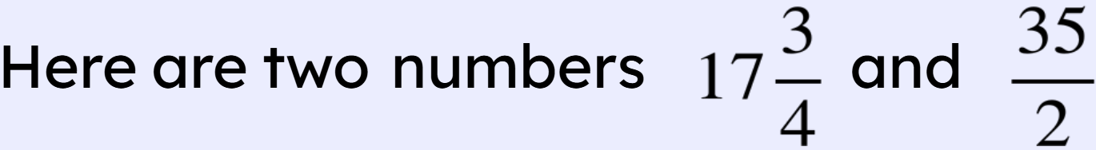
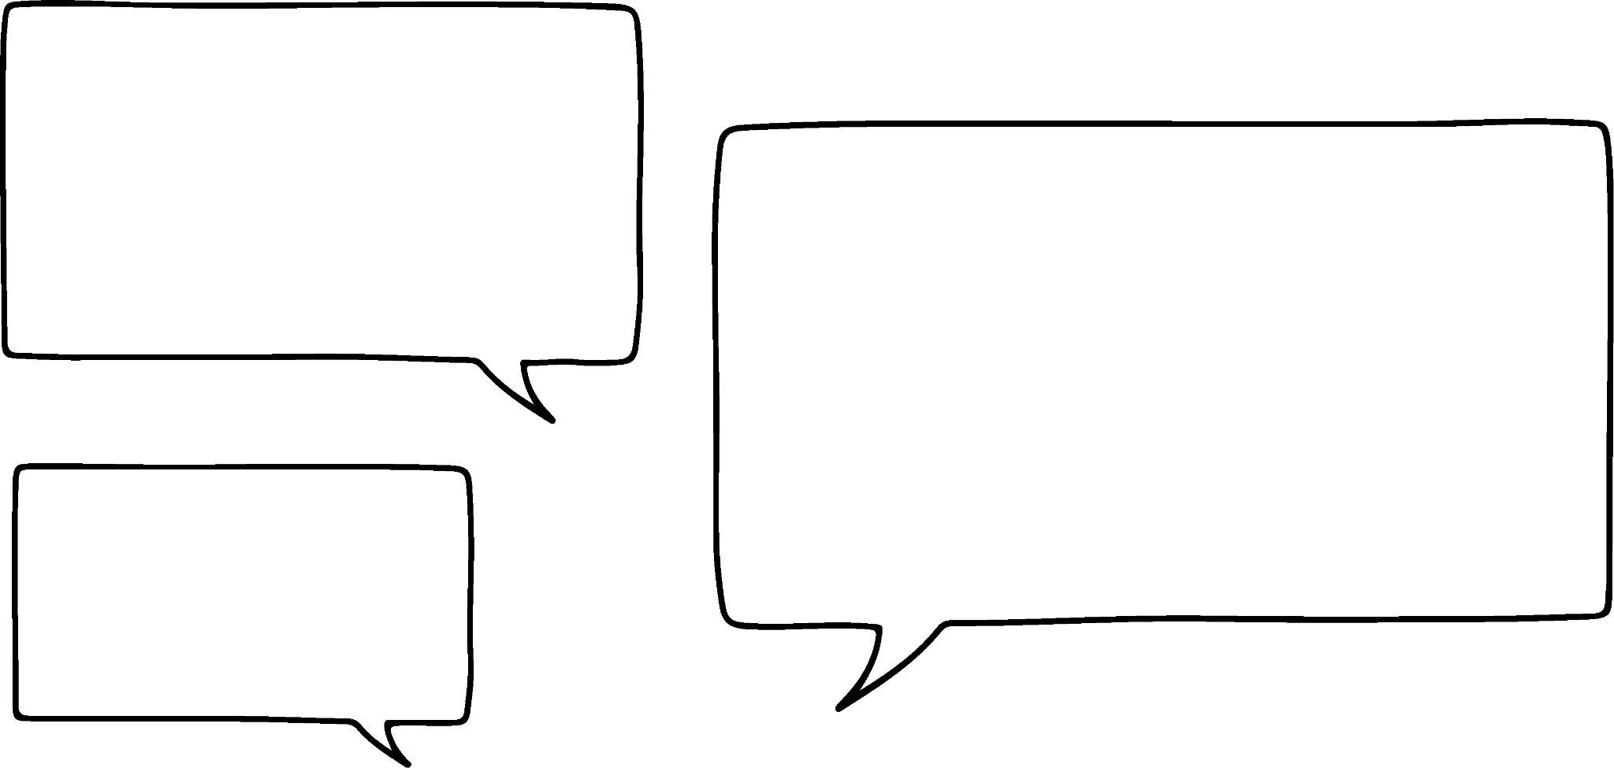
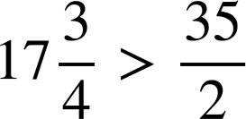
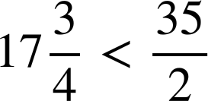

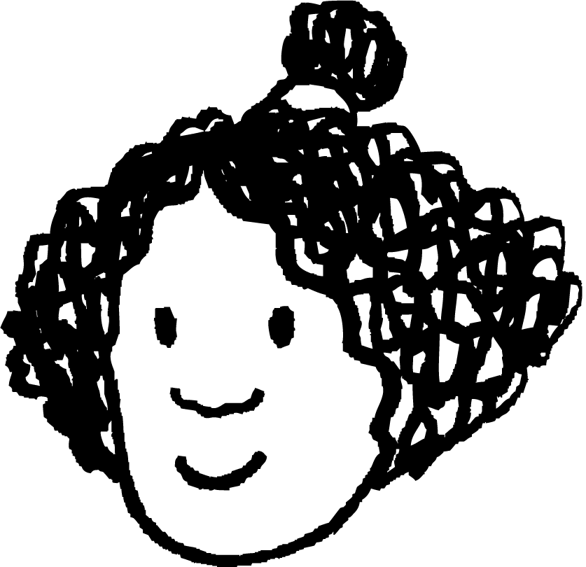
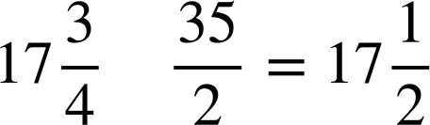
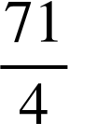
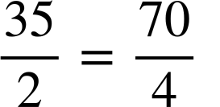
Comparing mixed numbers and improper fractions
Aisha
Izzy
Who is correct? Explain.
Making a common denominator we have
Aisha is correct.

Slide 36
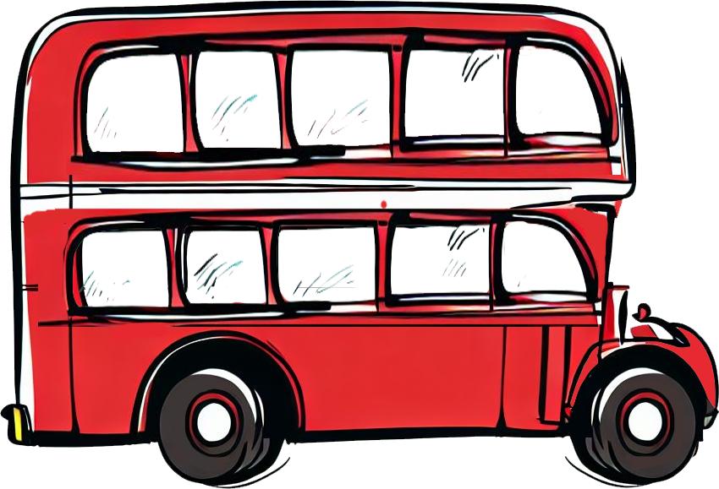
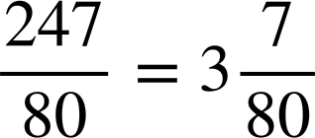
Comparing mixed numbers and improper fractions
If a bus has 80 seats and there were 247 people, what would the calculation be to work out how many buses are needed?
Therefore we need 4 buses as we cannot have of a bus.

Slide 37
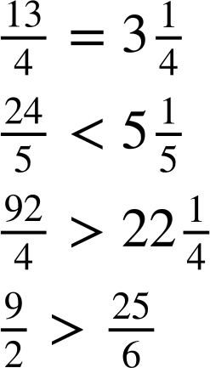
Comparing mixed numbers and improper fractions
1) Insert the symbol <, > or = to make the following statements true.
a)
b)
c)
d)

Slide 38

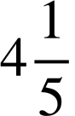

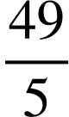
Comparing mixed numbers and improper fractions
2) Two gardeners are putting a fence around a rectangular garden.
One gardener measures the length to be
m
m and the other gardener measures
m
the
width
to
be
m.
Fence panels cost £22 per m.
How many fence panels are needed?
What is the total cost?

Slide 39
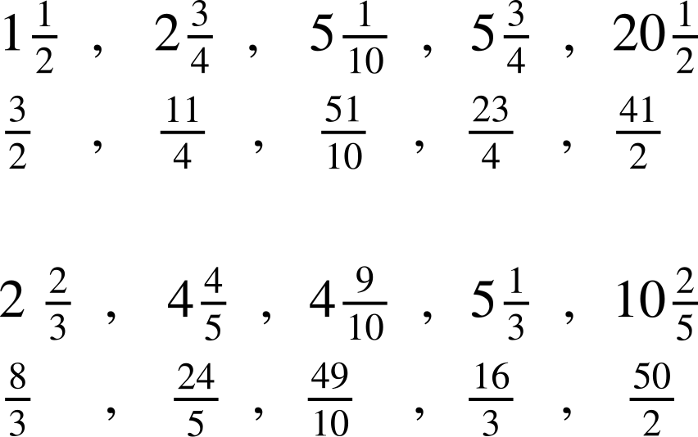
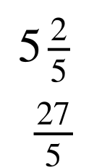
Comparing mixed numbers and improper fractions
3) The following have been put in ascending order.
The mixed number is above and the equivalent improper fraction is below.
Fill in the gaps.
a)
b)

Slide 40
Comparing mixed numbers and improper fractions
1) Insert the symbol <, > or = to make the following statements true.
a)
b)
c)
d)

Slide 41
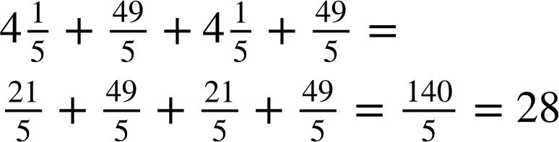
Comparing mixed numbers and improper fractions
2) Two gardeners are putting a fence around a rectangular garden.
One gardener measures the length to be
m
m and the other gardener measures
m
the
width
to
be
m.
Fence panels cost £22 per m.
How many fence panels are needed?
fence panels

Slide 42
Comparing mixed numbers and improper fractions
2) Two gardeners are putting a fence around a rectangular garden.
One gardener measures the length to be
m and the other gardener measures
the width to be m.
Fence panels cost £22 per m.
m
m
b) What is the total cost?
28 × 22 = £616

Slide 43
Comparing mixed numbers and improper fractions
3) The following have been put in ascending order.
The mixed number is above and the equivalent improper fraction is below.
Fill in the gaps.
a)
b)

Slide 44
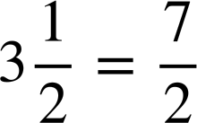
Checking and securing converting mixed numbers to improper fractions
An improper fraction is a fraction where the numerator is greater than or equal to the denominator.
We can write an integer as an improper fraction.
A mixed number is an improper fraction written as its integer part plus the fractional part, where the fractional part is a proper fraction.
Example
It is sometimes important to convert mixed numbers into improper fractions and vice versa so we can compare them.

Slide 45

© Oak National Academy 2023.
Produced in partnership with Mathematics in Education and Industry.
Licensed on the Open Government Licence v3.0, except where otherwise stated. See Oak terms and conditions.

